Slide 1
Introduction
This is the fifth week of the meeting about some allocated agendas and their execution.

Slide 2
Agendas
Remove irrelevant features related to delinquency
2. List the time and result of execution of the random classifier
3. Capture the result, precision, f1-score, and accuracy
4. Find the feature contribution
5. Review the literature review

Slide 3
Operation Carried in Data Set
Data Pre-processing
Splitting Data
Data Summarization
Classification
Finding Feature contribution

Slide 4
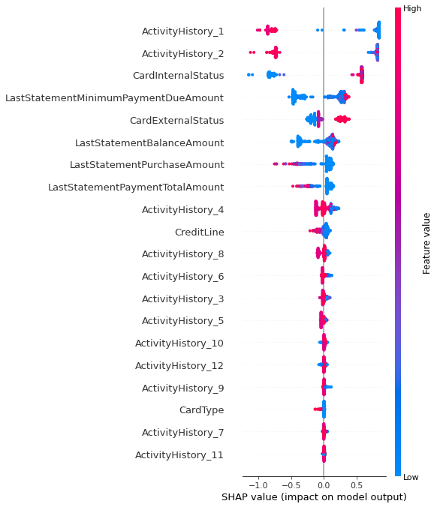
Shap_values Plot

Slide 5
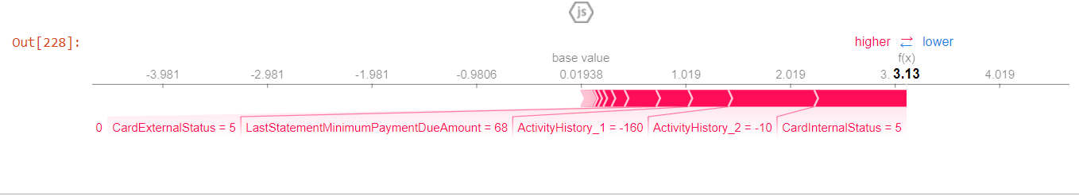
Shap Force Plot

Slide 6
Accuracy Score for 4 dataset
Dataset | Accuracy score
1 | 0.9955357142857143
10 | 0.9895833333333334
11 | 0.9895833333333334
100 | 0.9880952380952381

Slide 7
Precision Score of four datasets
Dataset
Dataset | Precision score
1 | 0.9855907780979827
10 | 0.9885714285714285
11 | 0.9772727272727273
100 | 0.9855491329479769

Slide 8
F1 Score of four datasets
Dataset
Accuracy score
Dataset
Dataset
Dataset
Dataset | F1 Score
1 | 0.9896907216494846
10 | 0.9911504424778761
11 | 0.9867060561299852
100 | 0.9900142653352354

Slide 9
Conclusion
This is the fifth week, and the processing of the random classifier is going on.

